Slide 1
Iteration 2
Bienenkönigin (Queen Bees)
Mikhaela, Meredith, Narbada, Minu, Jack

Slide 2
Agenda
Current System – Issues and Possible Solutions
Prototypes
Economic Feasibility
Value/ROI

Slide 3
Current System
Issues:
Website is not very user-friendly
Lackluster
Images/Videos
Mission Statement
Social Media
Missing a “call to action” – encouragement to donors
Sponsors
Impact
No Separate login for employees
Inventory tracking
Employee access to specific links

Slide 4
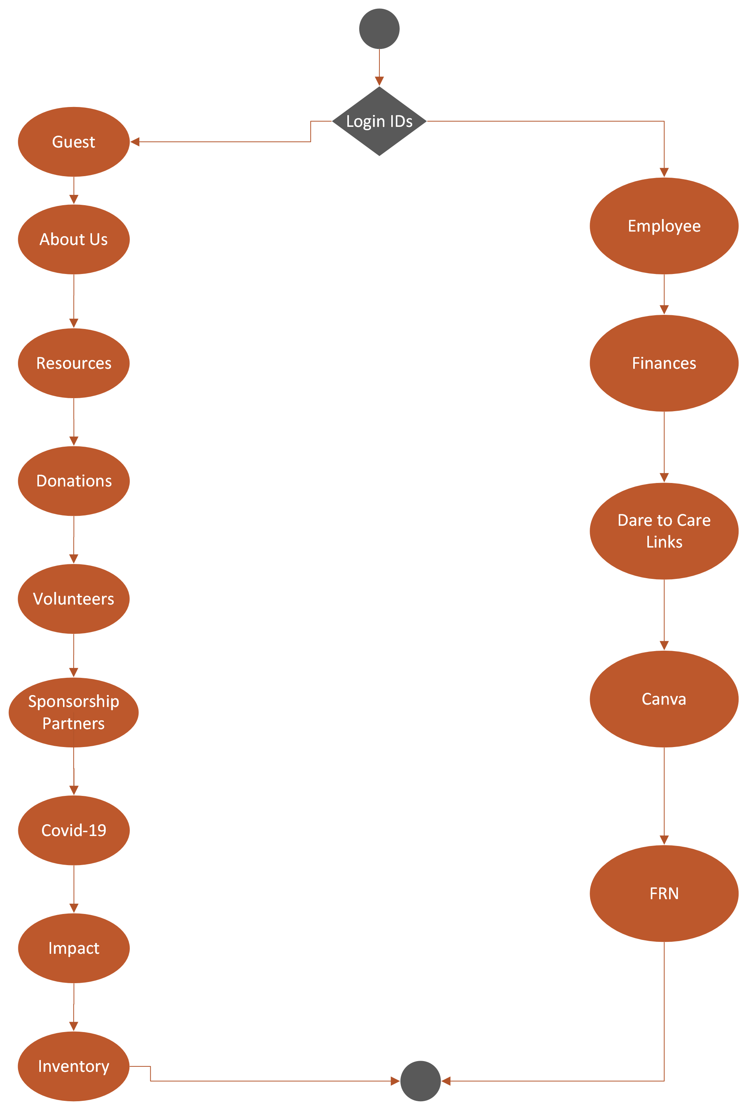
To-Be Process Model
Will be represented in 3 prototypes

Slide 5
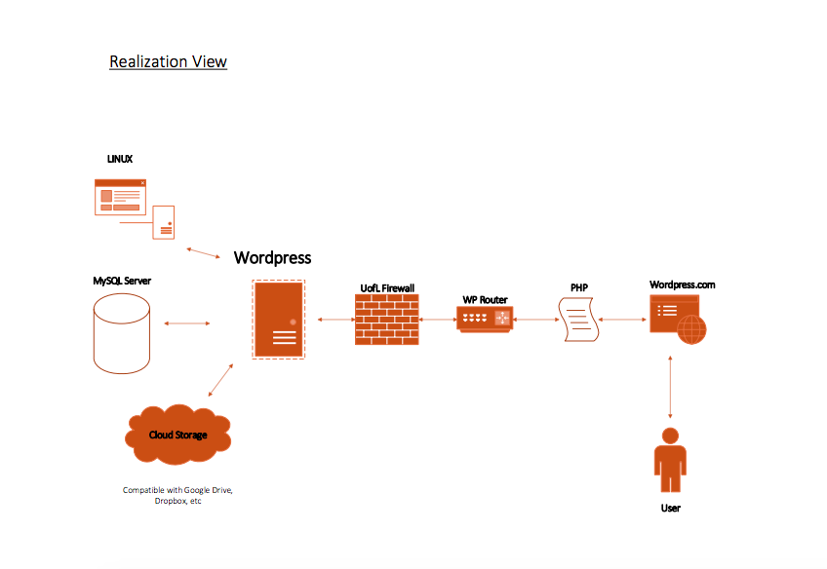

Slide 6
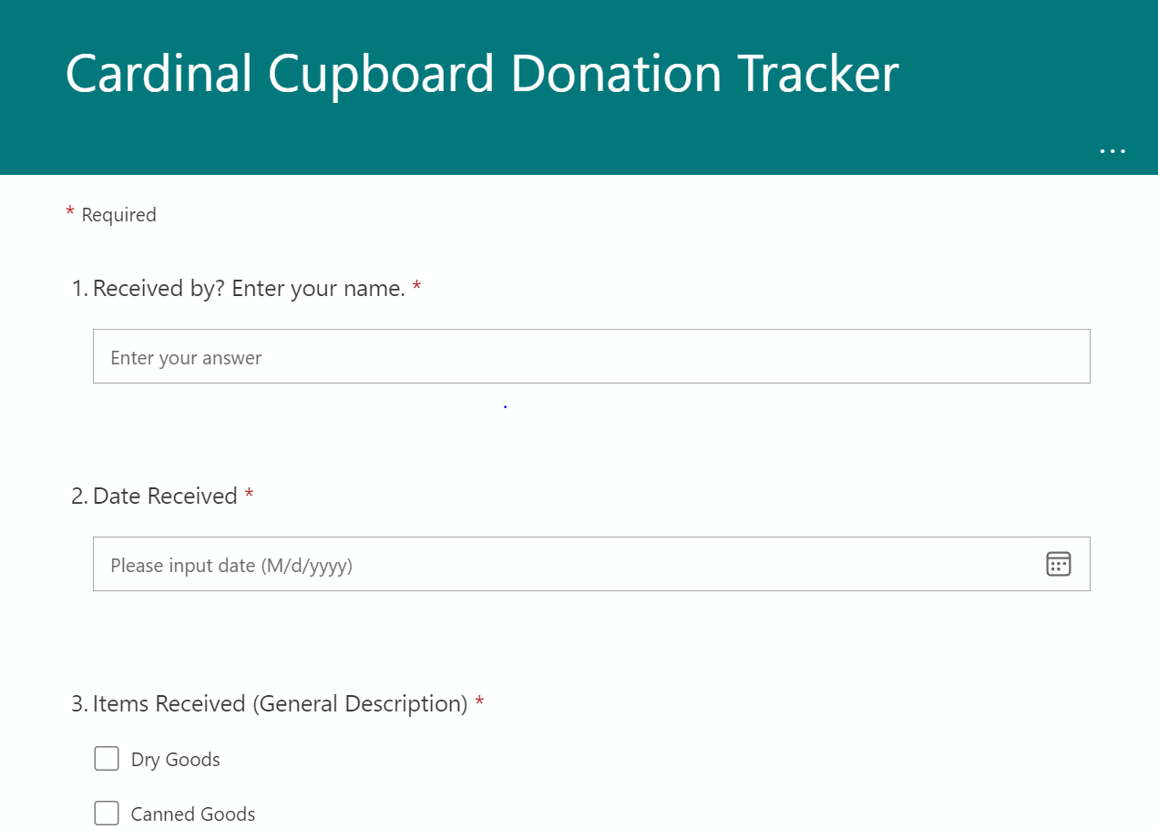
Cardinal Cupboard Experience Survey
Cardinal Cupboard General Survey
Donation Tracking Form
3 Mock Web Forms
Using Microsoft Forms
Available to anyone to fill out
Donation tracker can be limited to employees
Allow for accumulated responses – can filter by date
Downloadable to excel
Customizable

Slide 7
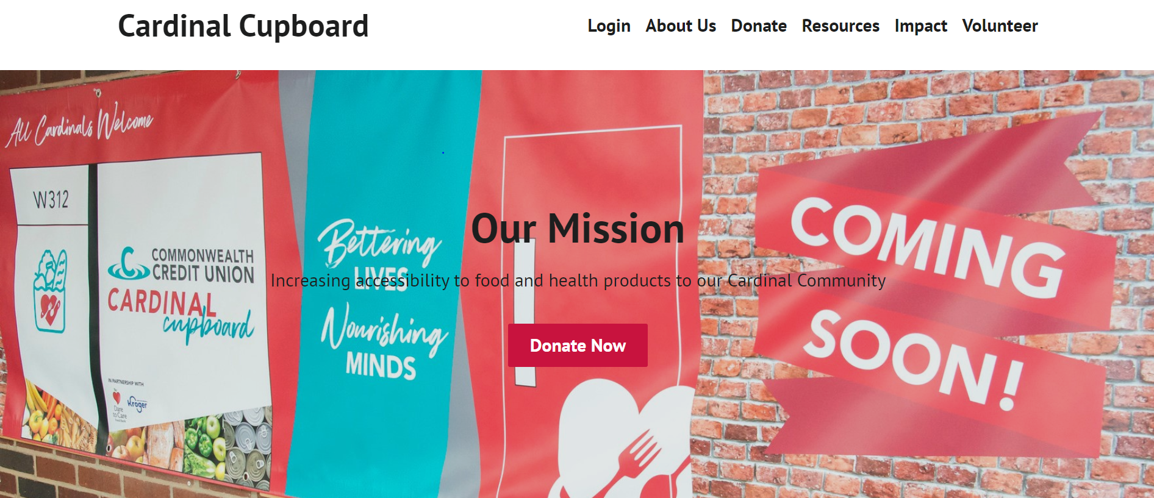

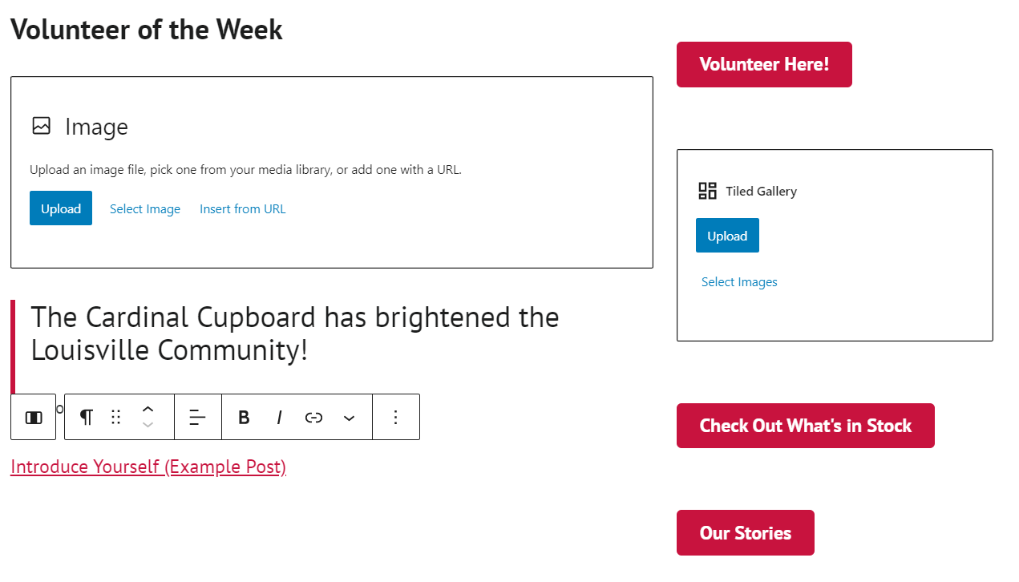
Landing Page Prototype: High-level view

Slide 8

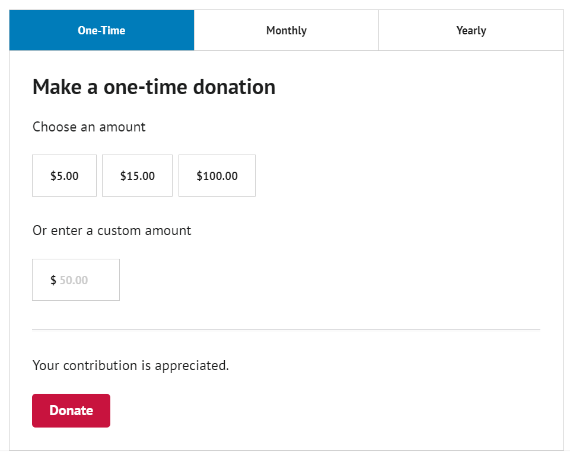

Slide 9
Economic Feasibility
Based On:
100 Donors in 1st year
Increase by 20 each year
The initial $100,000 in grants per year
avg. nonprofit grant ($6000)
Initial WordPress fees for plugins - $300
Stripe fees – 2.2% + $0.30 per transaction
Licensing, Maintenance, Misc. Expenses
$2250/year

Slide 10
Optimistic
NPV: $80,602
ROI: 1871%
Based on an increase in grants: $6,000/year

Slide 11
Conservative
NPV: $71,059
ROI: 1683%
Based on an increase in grants: $6,000 in year 3

Slide 12
Expected
NPV: $75,042
ROI: 1763%
Based on an increase in grants : $6,000 in year 2 and 4

Slide 13
Summary
Summary
If the Cardinal Cupboard implements our systems/design…
Expected ROI of 1763%
NPV of $75,042 over 5 years

Slide 14
Questions?
Thank you for your time

